Slide 1
1 John 1:8-9
If we say we have no sin,
we deceive ourselves, and the truth is not in us. If we confess our sins, he is faithful and just to forgive us our sins and to cleanse us from all unrighteousness.

Slide 2
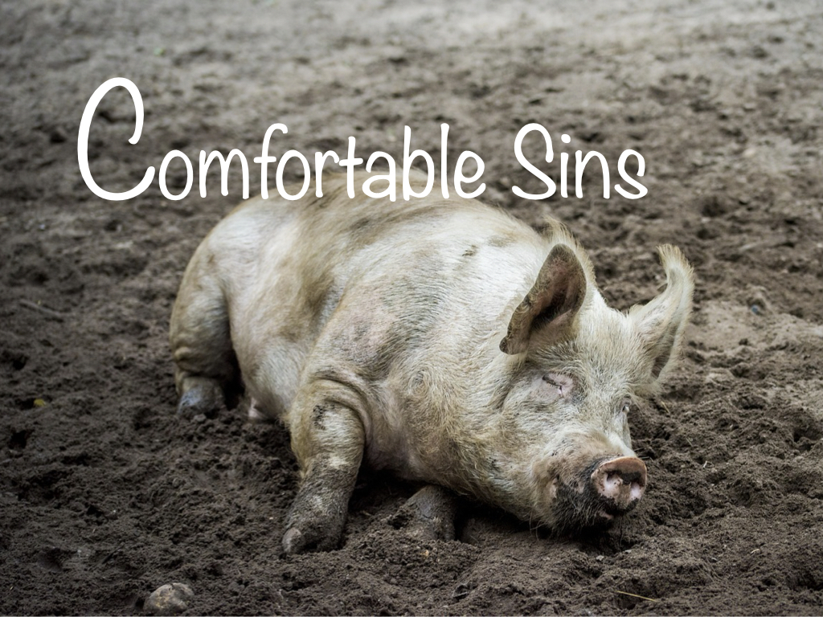

Slide 3
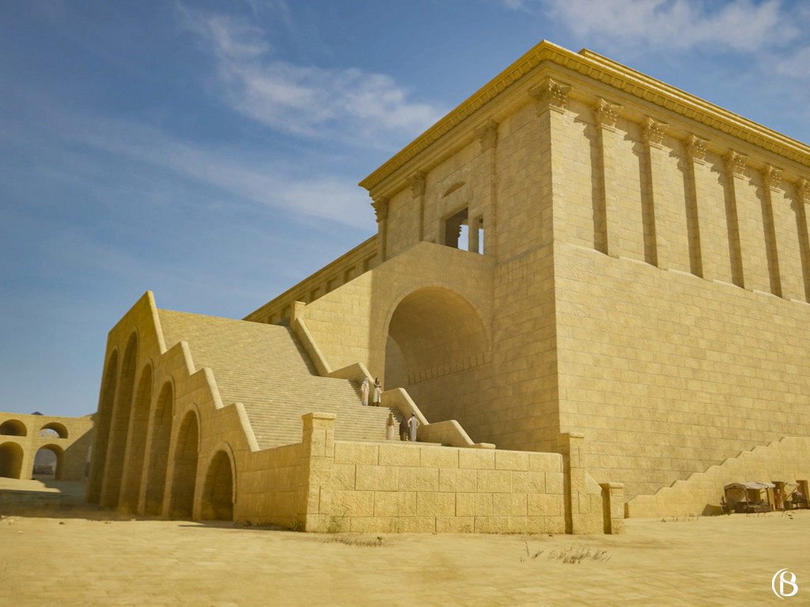
A False Sense of Security

Slide 4
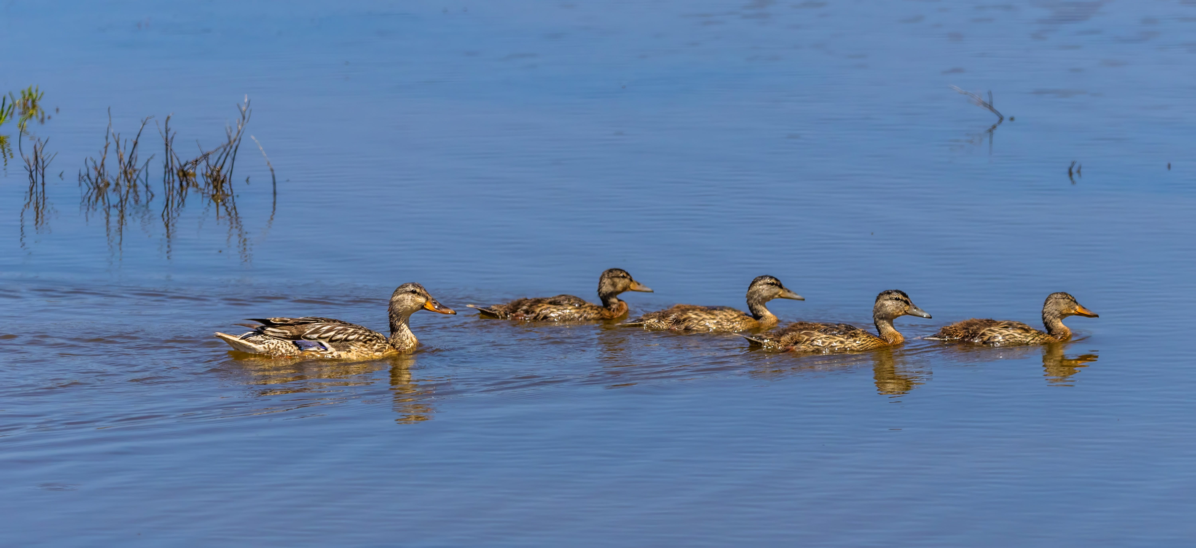
Family, Community, or Culture

Slide 5
Separate Worship
From Living Each Day

Slide 6
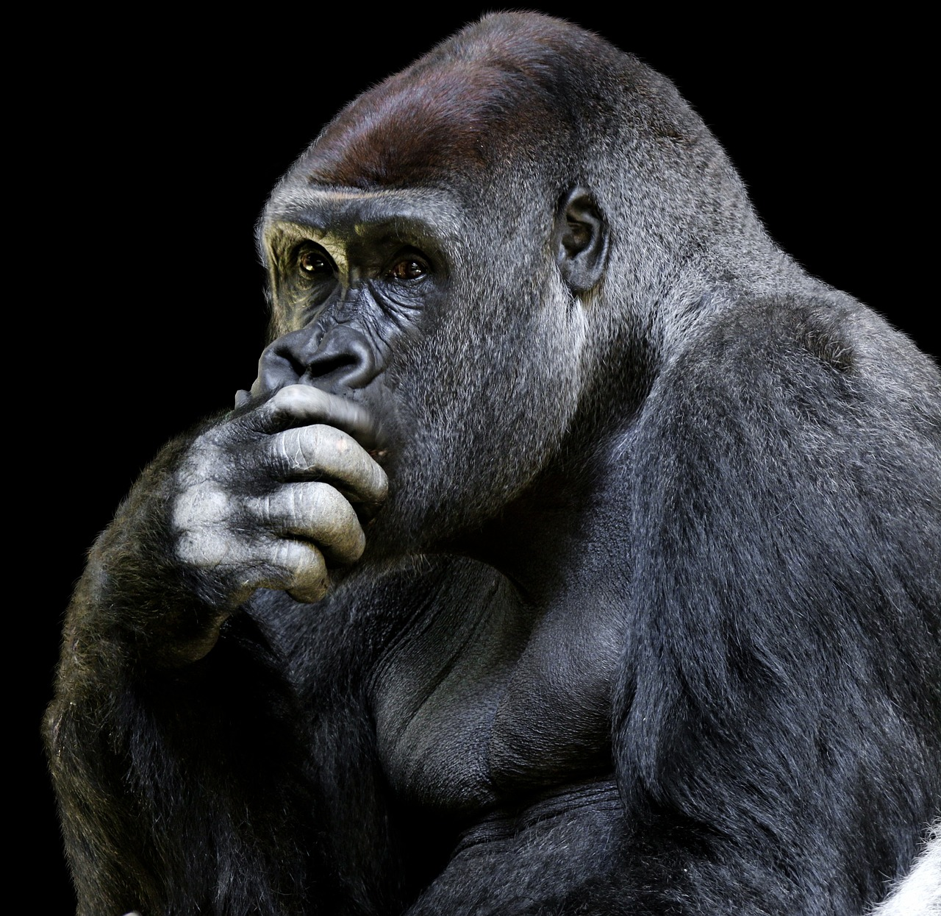
Trust in
my own judgement of right and wrong.

Slide 7
Ongoing sin

Slide 8
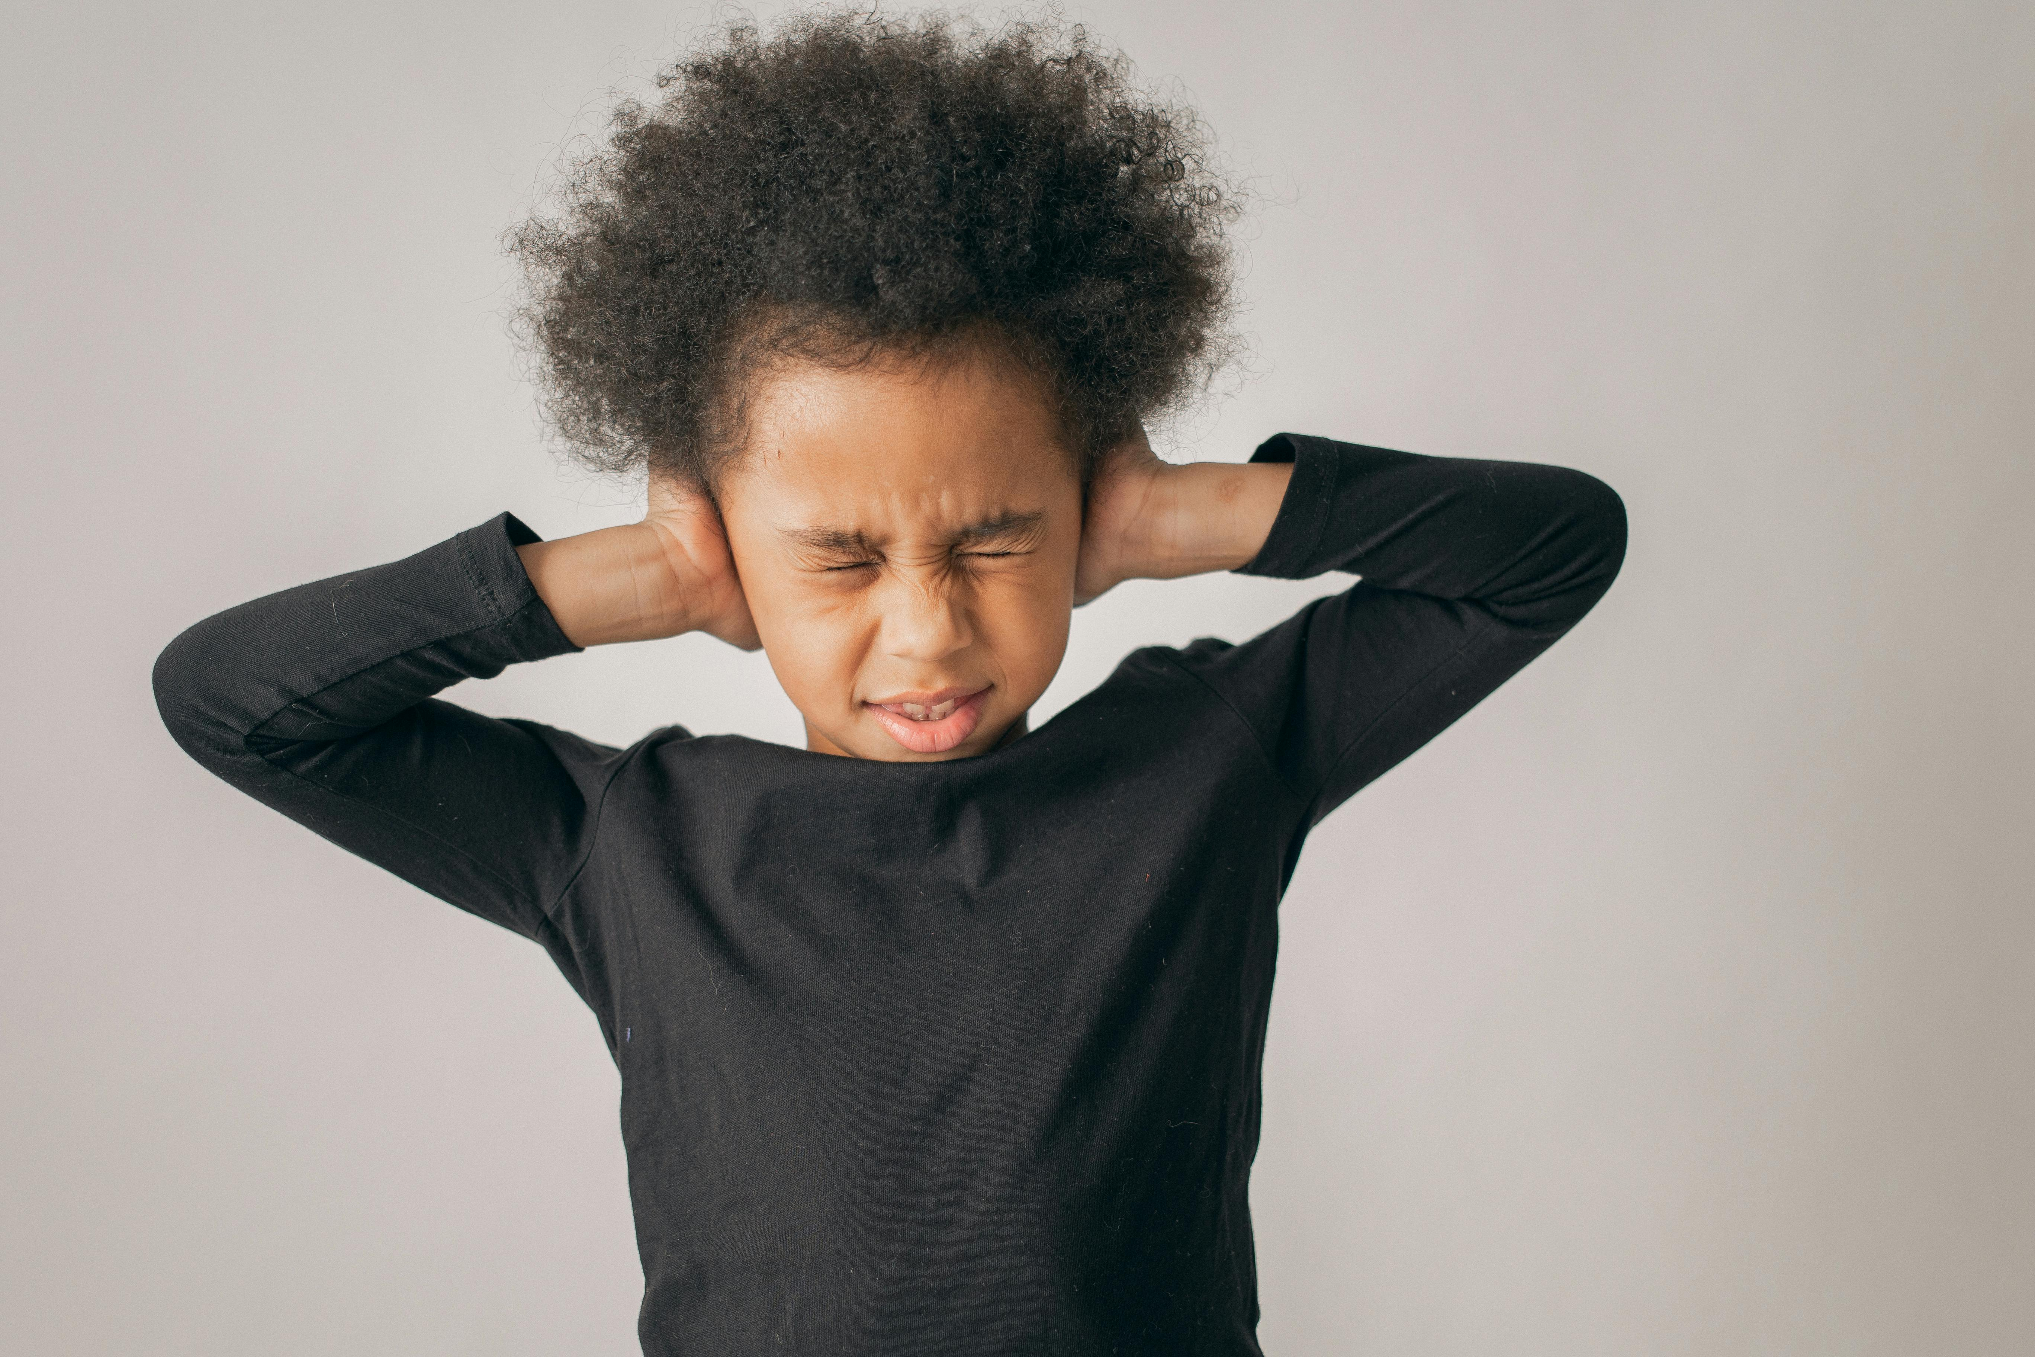
Unwillingness to listen to others

Slide 9
The Key:
Recognize
God is not comfortable
with my sin.

Slide 10
1 John 1:8-9
If we say we have no sin,
we deceive ourselves, and the truth is not in us. If we confess our sins, he is faithful and just to forgive us our sins and to cleanse us from all unrighteousness.

